Slide 1
ROTATION ABOUT
ARBITRARY AXIS

Slide 2
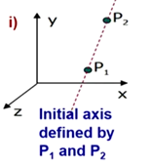

Slide 3
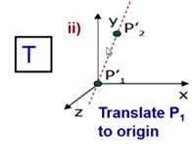
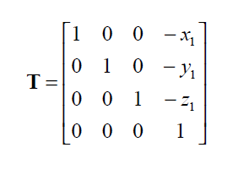

Slide 4
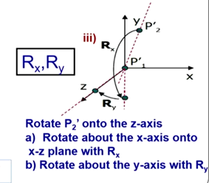

Slide 5
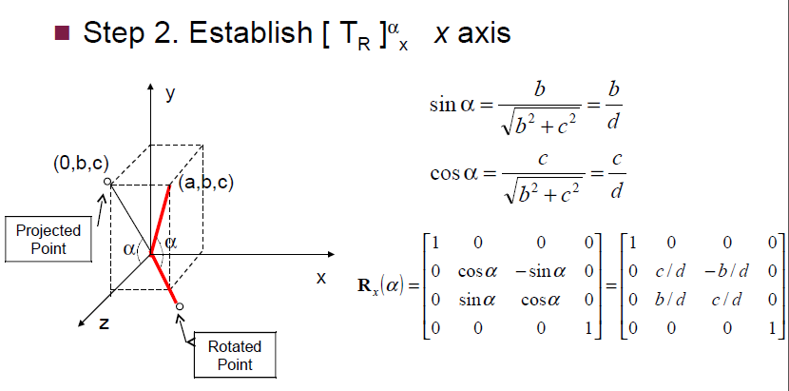

Slide 6
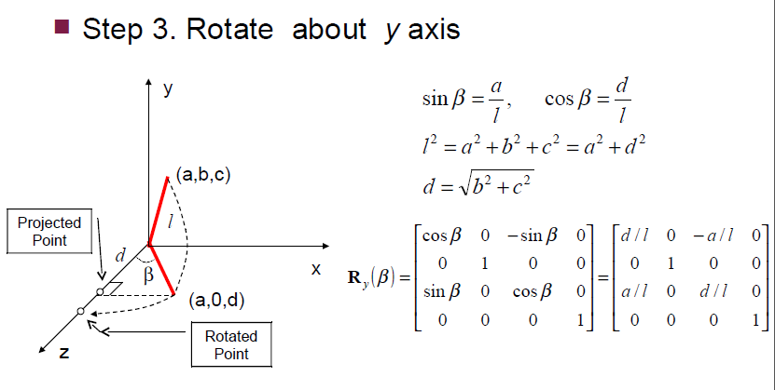

Slide 7
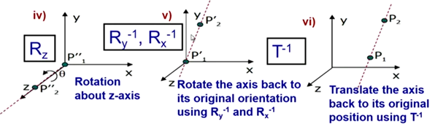
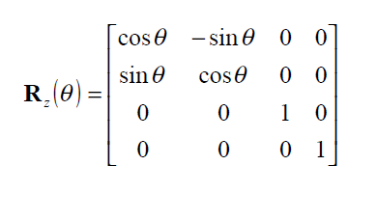

Slide 8

ROTATION ABOUT ARBITRARY AXIS

Slide 9
REFLECTION ABOUT
ARBITRARY PLANE

Slide 10
It is often necessary to reflect an object through an arbitrary plane other than one of the coordinate planes like x = 0, y = 0 and z = 0.
The basic idea is to make the arbitrary reflection plane coincide with one of the coordinate planes.
Assuming an arbitrary plane in space is given by three points
P0 (x0, y0, z0), P1 (x1, y1, z1) and P2 (x2, y2, z2), these points are non-collinear.

Slide 11
Translate the reflection plane to the origin of the coordinate system with the help of known P0 (x0, y0, z0) point.
2. Perform appropriate rotations to make the normal vector of the reflection plane at the origin until it coincides with the +z-axis.
3. After that reflect the object through the z = 0 coordinate plane.
4. Perform the inverse of the combined rotation transformation in step 2.
5. Perform the inverse of the translation in step 1.

Slide 12
From the three points of the reflection plane is easy to calculate the normal vector by the cross product of a = P1 − P0 and b = P2 − P0 vectors:
n = a × b

Slide 13
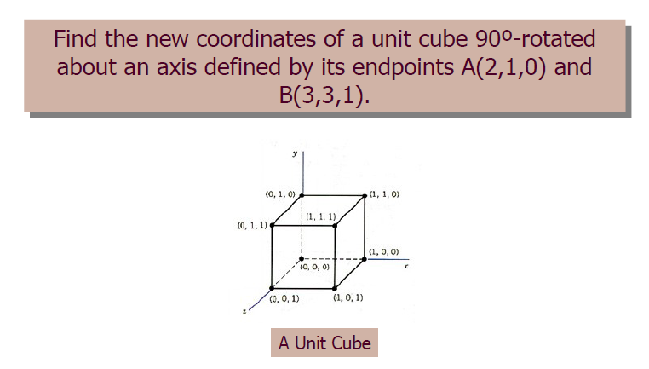
Examples: Rotation about arbitrary axis

Slide 14
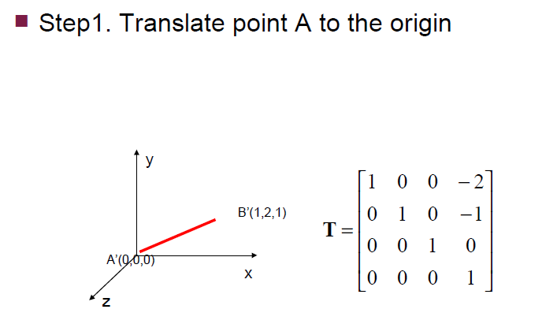
Examples: Rotation about arbitrary axis

Slide 15
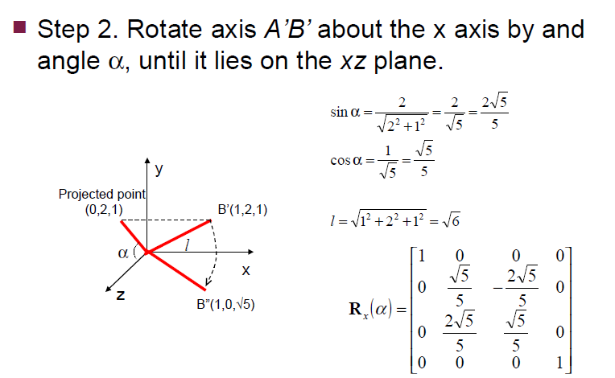
Examples: Rotation about arbitrary axis

Slide 16
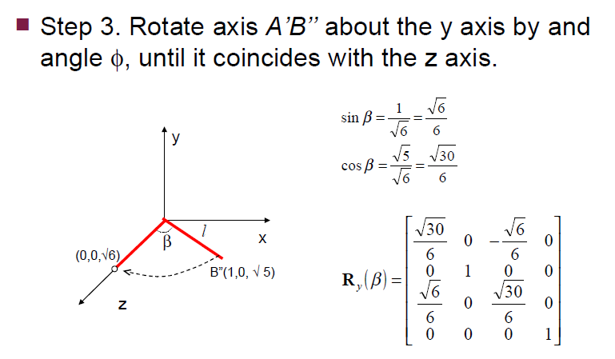
Examples: Rotation about arbitrary axis

Slide 17
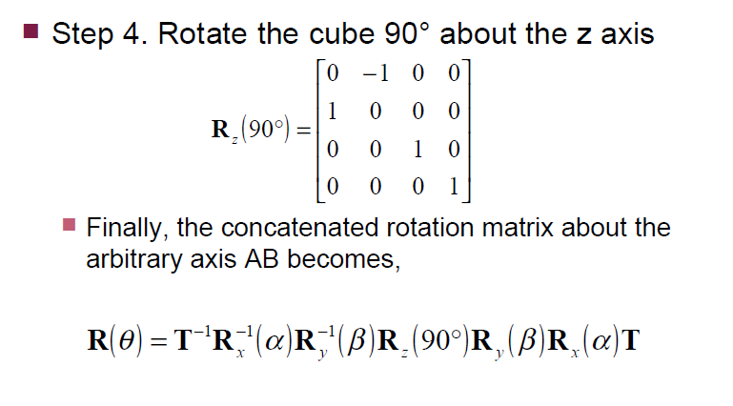
Examples: Rotation about arbitrary axis

Slide 18
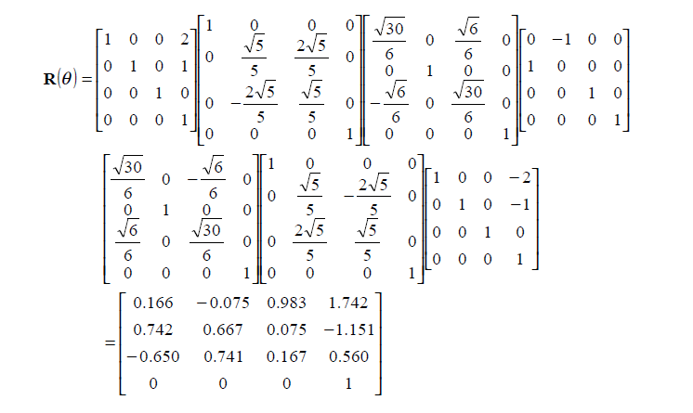
Examples: Rotation about arbitrary axis

Slide 19
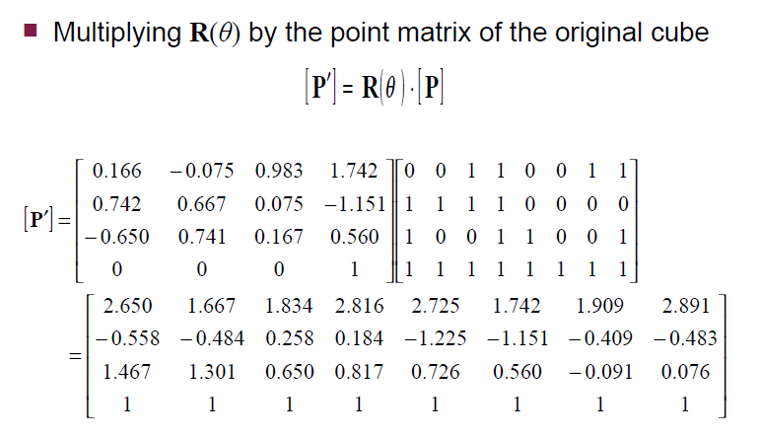
Examples: Rotation about arbitrary axis

Slide 20
Example: Reflection about arbitrary plane
Find the reflection of a point P(2,4,-6) in a plane through the points A(2,1,6), B(3,-2,-1) and C(3,1,5)
Ans: (8, -8, 0)
Find the reflection of a point P(1,2,3) in a plane through the points A(2,1,0), B(3,-2,-2) and C(3,1,7)

